Slide 1
BROCHURES

Slide 2
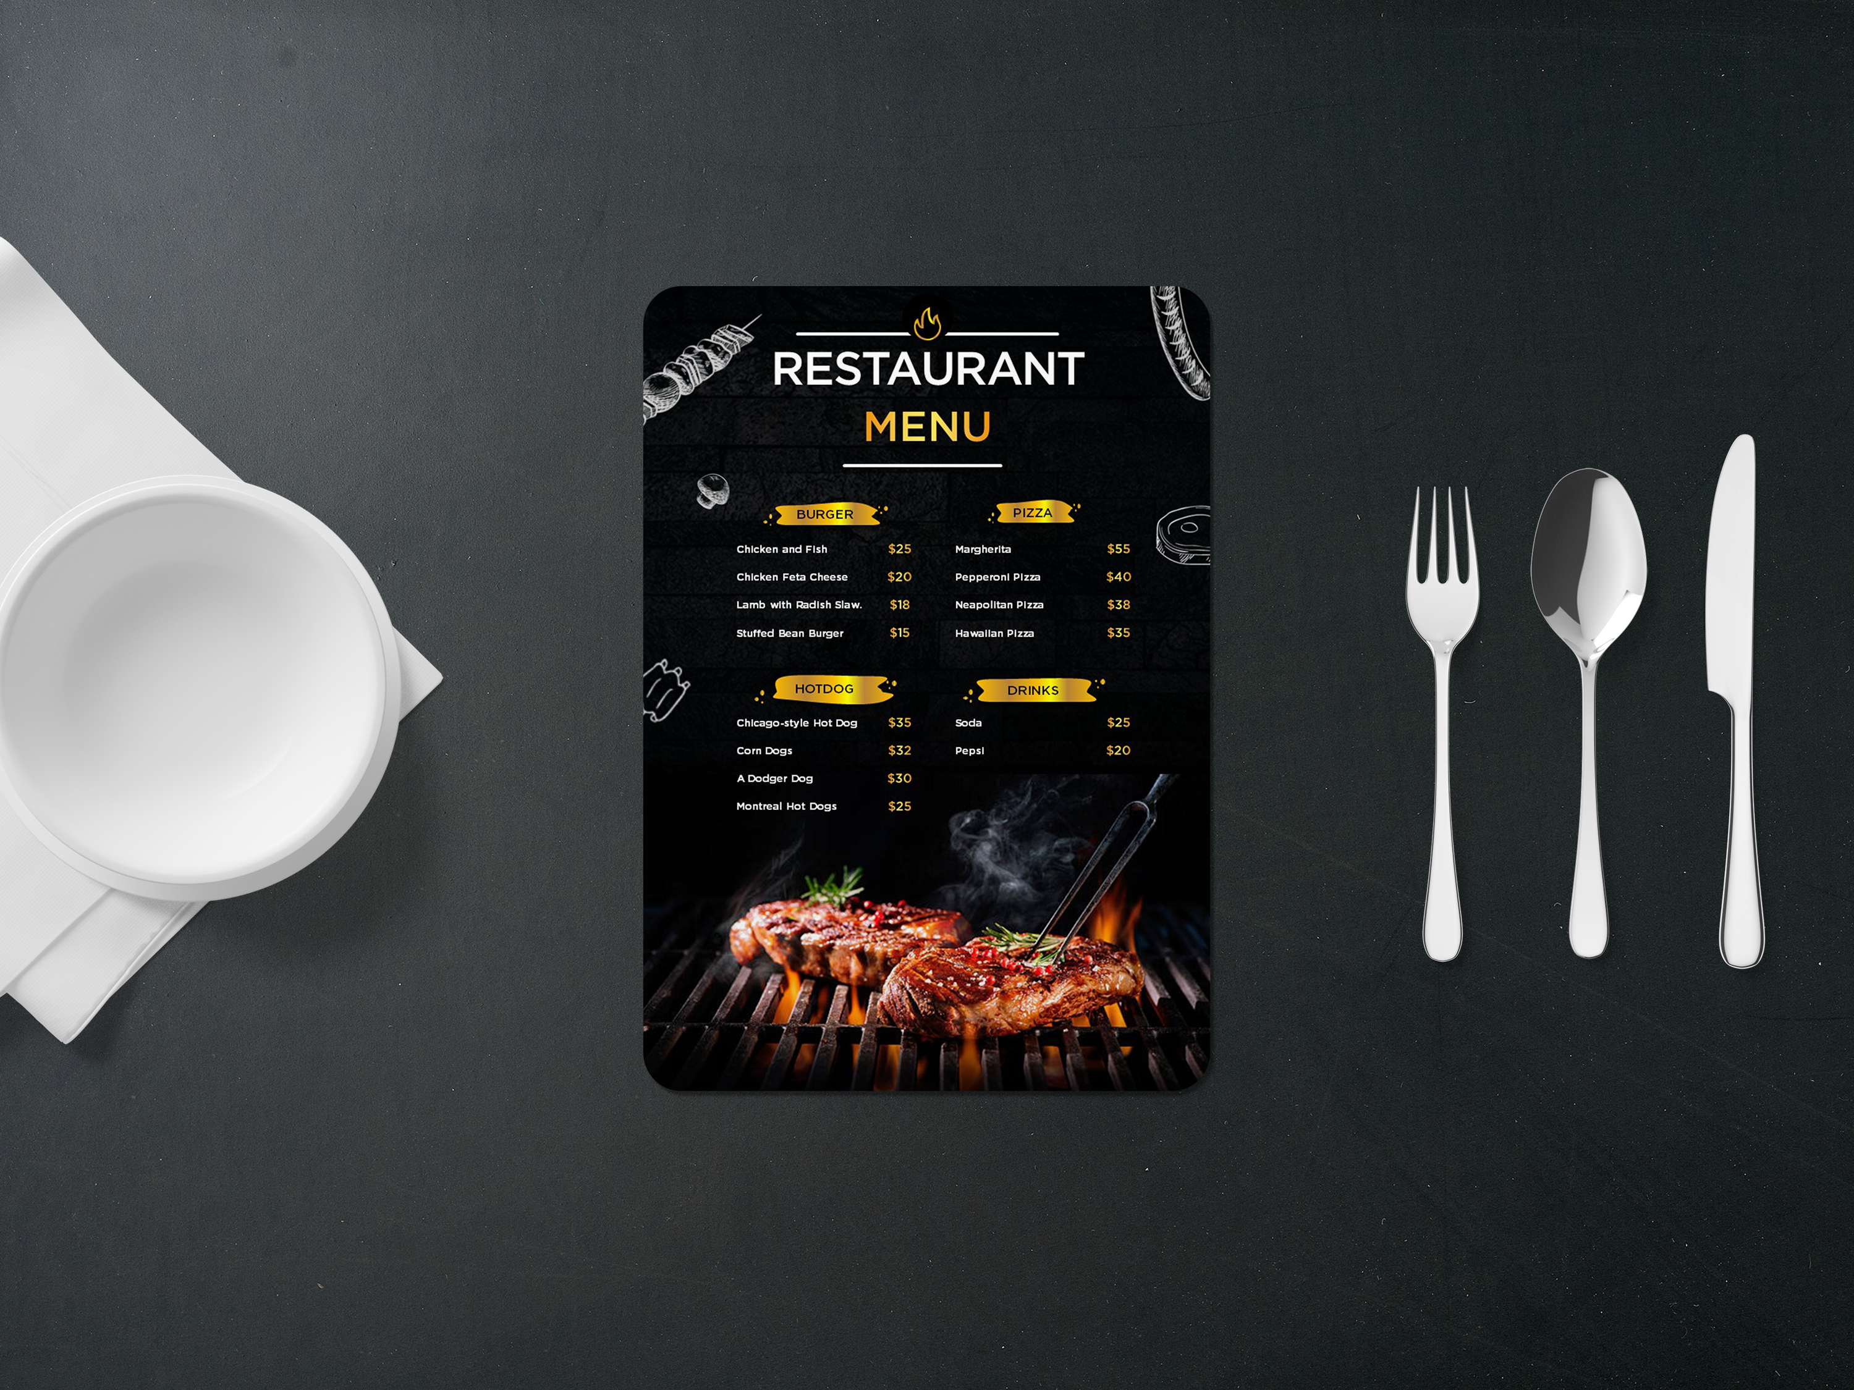

Slide 7
